Slide 1

Car name plate detection
User Manual
Author: Sanat Juneja
Notes:
Preworks course home assignments

Slide 2
Table of Contents
List Table of Contents here:-
Acknowledgment
About me
About my internship journey with clevered
About my app
How do I use the app
Contact person

Slide 3
Acknowledgements
A small vote of thanks for all who have helped me in this journey of App Development – my parents, Ms. Mani, Dr. Ken Khan, Google collab.

Slide 4
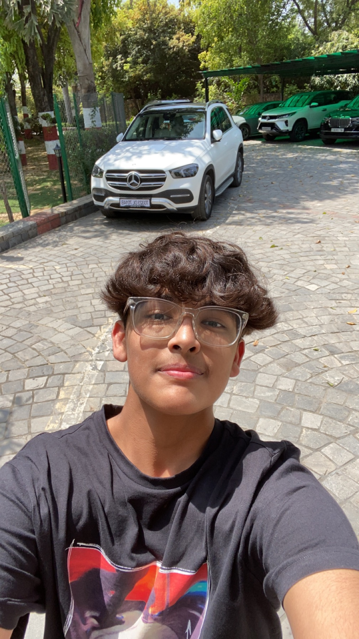
About Me..
Student’s Photograph
Student’s Introduction
I am in 11th grade, An IB DP student. Studying in pathways school Gurgaon, keen about learning in dept in the field of computer science.

Slide 5
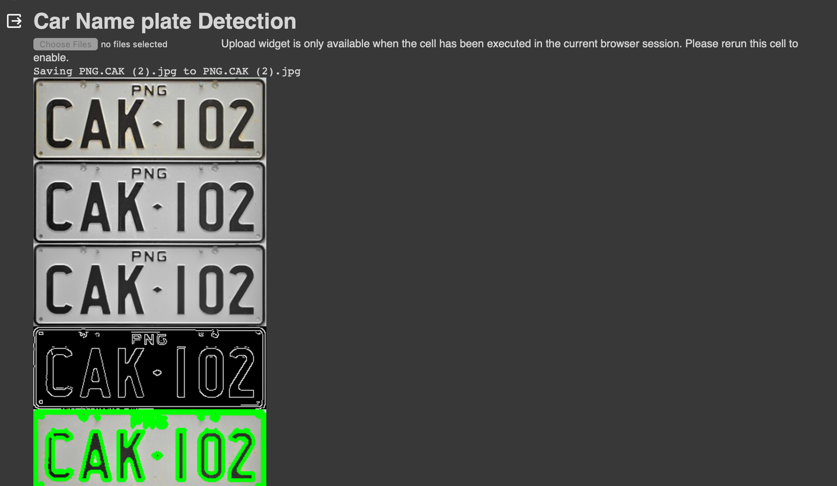
About My Internship Journey with Clevered..
It was a fruitful experience; great mentors and I got all the help I needed. Learned a lot of new technical parts of coding through this experience.

Slide 6
About App..
App’s Main Menu
App’s Introduction
It is a Car name plate detection, able to detect the numbers from the images of a car number plate.

Slide 7
How do I use the App?
Initially, I execute the code, followed by the selection of an image featuring a car's nameplate. Subsequently, the application employs its functionality to identify the alphanumeric characters on the nameplate and generates the corresponding output.

Slide 8
Option Name(This will be repeated for each option of the App)
Need access to stable internet
Need access to google collab
Need a clear image of a car number plate

Slide 9
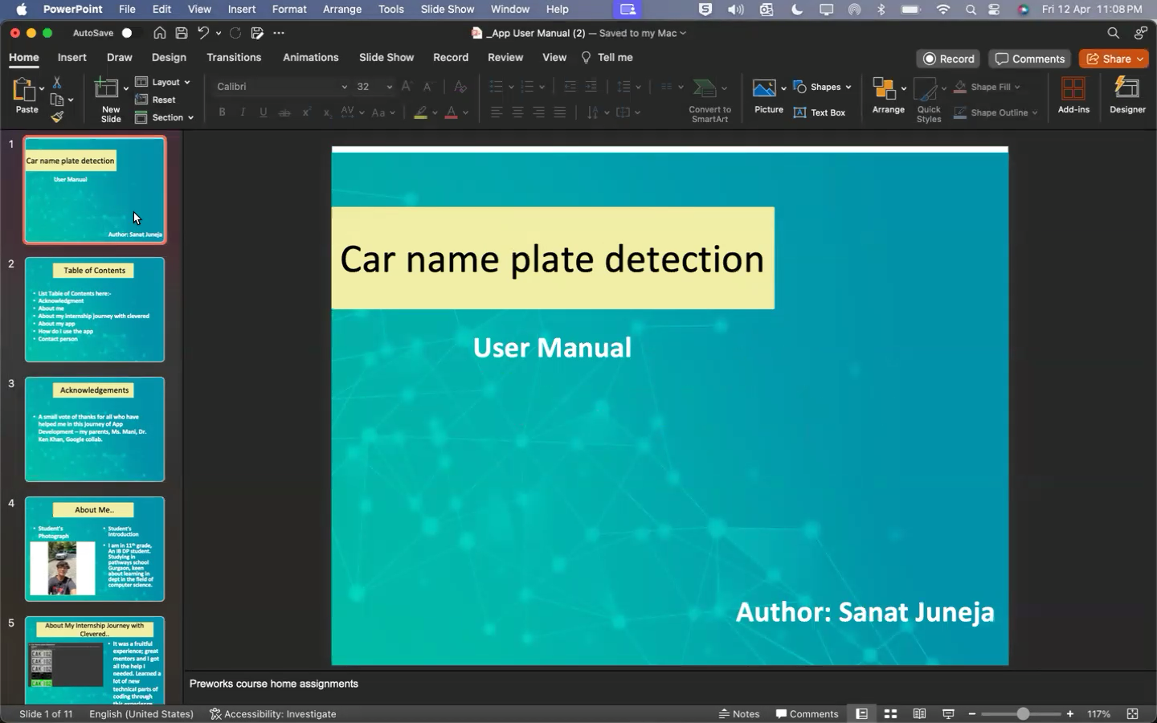
Demo Video

Slide 10
Contact Person
Please reach out to Sanat Juneja at sanatjuneja100@gmail.com for any questions/ concerns/ suggestions on the App

Slide 11
Thank you!

